Slide 1
26. Miscellaneous: Git; Type Conversions; Function Selection
ECE 309
Dr. James Tuck

Slide 2
Objectives
Describe what git it is and why we use it.
Describe and implement custom type conversions to and from a class.
Describe the function selection algorithm in C++ and why it’s needed.

Slide 3
Git
The purpose of Git is to manage a project, or a set of files, as they change over time.[2]
Git stores this information in a data structure called a repository. [2]

Slide 4
Contents of a git repository
The files you add to the repository
A collection of edits, called commits, that you make to the repository. Commits include:
Changing the content of a file (e.g. fixing code, updating a readme)
Adding new source code files
Removing source code files
Changing directory structure
Commits can be small (one line of one file) or big (add 100 files all aat once)

Slide 5
Example
Edit a file in class repo and commit it. Show the commit number.

Slide 6
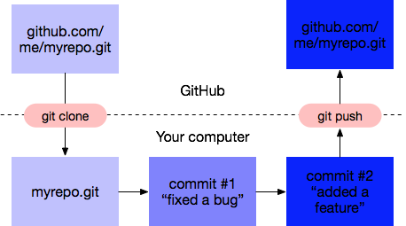
Basic strategy for git
Create your own new repository or fork one
Edit some files on your own computer
Compile and test them
Commit the changes
If you want to do more, go back to 2
When ready, push commits to GitHub to share with others

Slide 7
Git users think in terms of commits
A repo is actually a collection of commits
We can view the history of the repo by looking through the commit history
Go to GitHub, pick a file, and look at the history of the file
If we make a bad commit that breaks our code, we can always revert to a previous good commit
It’s better to avoid this through proper testing

Slide 8
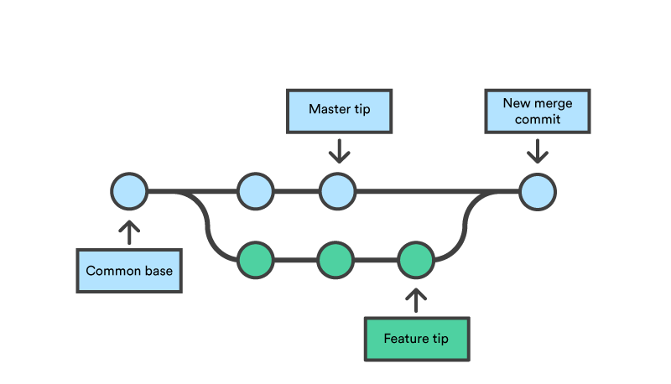
Git repo is really a directed acyclic graph
nodes: are commits
edges: chronologically order the commits
https://www.atlassian.com/git/tutorials/using-branches/git-merge

Slide 9
Two common operations
git branch: start a new sequence of commits from a given existing commit
git merge: take two different commits and merge them into a single commit

Slide 10
Observing the work of others
git pull: when someone else does a push, update your repo to see it using pull
Copies all of their commits into your local repo
Typical flow: pull their changes into a pristine master branch, then merge into your local development branch

Slide 11
Git Best Practices
Commit related changes together
Commit often, but don’t commit half done work
Test before you commit --- error-free compile is a bare minimum
Write good commit messages
Before you push, pull the code of others and make it work with your own.
Push your code to shared repository when it’s ready for use by others; don’t force others to debug your code.
See [2] for more info.

Slide 12
Review of Type Conversions
class A {
int x;
public:
A(int ax) { x = ax;}
};
A a = 5; // convert int to A using constructor, calls constructor A(5)
int x = a; // illegal, no viable conversion from class A to int

Slide 13
Constructors convert to a class from their parameter type
Constructors that take a single argument are interpreted as type converters to a class
class A {
int x;
public:
A(int ax) { x = ax;} // convert from int to class A
A(double d) { x = d; } // convert from double to class A
A(const char* s) { x = atoi(s); } // convert from string to class A
};

Slide 14
How do we convert from a class to another type?
Conversion operators let us convert A back to another type:
class A {
int x;
public:
A(int ax) { x = ax;} // convert from int to class A
A(double d) { x= d; } // convert from double to class A
A(const char* s) { x = atoi(s); } // convert from string to class A
operator int() const { return x; } // convert class A to int
};

Slide 15
Type Conversions
class A {
int x;
public:
A(int ax) { x = ax;}
operator int() const { return x; } // convert class A to int
};
A a = 5; // convert int to A using constructor, calls constructor A(5)
int x = a; // now it works! Compiler calls operator int() function
printf(“%d”, (int)a ); // also works here as an explicit cast!
printf(“%d”, int(a) ); // alternative syntax: also works this way

Slide 16
Writing your own type conversion
Let’s say you want to convert to a typename:
operator typename();
The conversion function must be a class member function.
The conversion function must not specify a return type.
The conversion function must take no arguments.

Slide 17
If we defined operator int() in a C++ file
class A {
int x;
public:
A(int ax) { x = ax;}
operator int() const; // convert class A to int
};
// classname precedes operator keyword, just like with overloaded operators
// but there’s a space before typename
A::operator int() const {
return x;
}

Slide 18
Which function does the compiler pick?
Given function overloading, templates, and template overloading, there are many possible functions to choose from.
Here’s a broad overview of the process:
Phase 1 - assemble a list of candidate functions that have the same name as the called function.
Phase 2 - Assemble a list of viable functions:
Same number of arguments
Arguments match, possibly through conversions
Phase 3 - Determine if there is a best viable function, or raise an error.

Slide 19
Example
may(‘B’); // which function is called?
List of candidate functions with the same name:
int may(int,int);
void may(int);
float may(float, float=3);
void may(char);
char *may(const char*);
char may(const char&);
template<typename T> void may(const T &);
template<typename T> void may(T*);

Slide 20
Example - eliminate based on arguments
may(‘B’); // which function is called?
List of candidate functions with the same name:
int may(int,int);
void may(int);
float may(float, float=3);
void may(char);
char *may(const char*);
char may(const char&);
template<typename T> void may(const T &);
template<typename T> void may(T*);

Slide 21
Example - eliminate based on promotions and conversions
may(‘B’); // which function is called?
List of candidate functions with the same name:
int may(int,int);
void may(int); // char promoted to int
float may(float, float=3); // promote char to float
void may(char); // exact match
char *may(const char*); // not allowed
char may(const char&); // match?
template<typename T> void may(const T &); // match?
template<typename T> void may(T*); // not allowed
Integral types (like char, int) cannot be implicitly converted to a pointer type.

Slide 22
C++ order of preference for best fit
Exact match, with regular functions outranking templates
Break a tie using constness, if only reference or pointer formal arguments involved.
For a tie among templates, pick the one that’s more specialized.
Conversion by promotion (char to int)
Conversion by standard conversions (int to char, or long to double)
Conversion by user-defined conversions

Slide 23
Conversions considered exact matches
From actual argument | To formal argument | Rationale
Type | Type & | If an lvalue, pass by reference
Type & | Type | Downgrade to pass by value (make a copy)
Type [] | Type * | Arrays are really pointers
Type & | const Type & | It’s okay to treat something as const that isn’t. It’s not ok to do the opposite, const must remain const!
Type | const Type
Type * | const Type*
Type | volatile Type | It’s okay to treat something as volatile that isn’t. (Not ok to do the opposite.)
Type * | volatile Type *

Slide 24
Example - rank based on promotions and conversions
may(‘B’); // which function is called?
Ordered list by preference, 3 exact matches; we can exclude the template by best fit requirements:
char may(const char&); // exact match
void may(char); // exact match
template<typename T> void may(const T &); // exact match
void may(int); // char promoted to int
float may(float, float=3); // promote char to float
char *may(const char*); // not allowed
template<typename T> void may(T*); // not allowed
int may(int,int);

Slide 25
Example - two exact matches remain
may(‘B’); // which function is called?
Ordered list by preference, 3 exact matches; we can exclude the template by best fit requirements:
char may(const char&); // exact match
void may(char); // exact match
Syntax error! We don’t know which one the programmer wants.

Slide 26
Deducing specializations
There are many special cases in type deduction and function selection not covered here.
The rules laid out here are good starting point.
Similar rules apply when selecting overloaded member functions in classes.

Slide 27
Summary
Git is a valuable resource for tracking changes to code.
Rule of thumb: Commit often, but only commit code that compiles to a shared repository.
Type conversions, from a class to another typename, are supported with special operator functions that take no arguments and have no return type.
Templates, template overloading, function overloading and type conversions make identifying the proper function challenging
Understanding how the compiler decides which function to use can help avoid mistakes and ambiguous definitions.
Compilers use a best fit policy that is intended to be intuitive.

Slide 28
References
1. https://www.sbf5.com/~cduan/technical/git/git-1.shtml
2. https://www.git-tower.com/learn/git/ebook/en/command-line/appendix/best-practices

